Slide 1
Randomized Algorithms CS648
Lecture 20
Miscellaneous applications of Backward analysis
Leader election in distributed environment – I
Random walk and electric networks

Slide 2
Birthday Paradox
Leader Election in
Distributed Environment

Slide 3
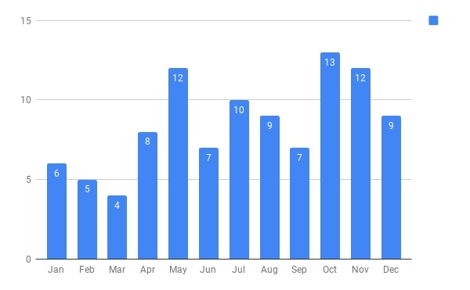
Birthdays of students who were present in the 1st class of CS203B taught in 2018
There are 102 students and 365 days.
What might be the chances of two students sharing a birthday ?

Slide 4



















































First 25 students
First 50 students
First 75 students
All 102 students
$$2$$
$$7$$
$$11$$
$$31$$
$$≈28$$
$$2$$
$9$^{th} January
$$3$$
$5$^{th} May
$$2$$
$27$^{th} July
$$2$$
$9$^{th} January
$$2$$
$9$^{th} January
$$2$$
$3$^{rd} June
$$3$$
$27$^{th} July
$$3$$
$27$^{th} July
$$2$$
$7$^{th} July
$$3$$
$27$^{th} July
$$2$$
$7$^{th} October
$$2$$
$2$^{th} October
$$2$$
$2$^{th} October
$$2$$
$7$^{th} October
$$2$$
$22$^{th} October
Can we explain this ?
$7$^{th} October
$$2$$
$8$^{th} December
$$3$$
$$2$$
$26$^{th} October
$$2$$
$1$^{st} November
$$2$$
$4$^{th} November
Yes, using a model studied multiple times in this course
$$2$$
$14$^{st} November
$$2$$
$10$^{th} December
Prob.>$0.5$
Prob.>$0.97$
Prob.>$0.9997$
Prob.>$0.9999997$

Slide 5
Balls into BINS

Slide 6

Balls into Bins
1 2 3 4 5 … $j−1$ $j$
Ball-bin Experiment: There are $j$ balls and $n$ bins.
Each ball selects its bin randomly uniformly and independent of other balls
and falls into it.
1 2 3 … $i$ … $n$

Slide 7
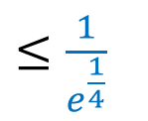
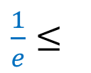




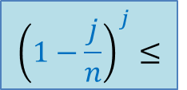


Balls into Bins
1 2 3 4 5 … $j−1 j$
Question : What is the probability that no bin has more than one ball ?
$$1⋅\left(1−\frac{1}{n}\right)⋅\left(1−\frac{2}{n}\right)⋅⋅⋅\left(1−\frac{j−1}{n}\right)$$
1 2 3 … $i$ … $n$
For $j=\sqrt{n}$
For $j=c\sqrt{n}\log{n}$
$${\left(1−\frac{j}{n}\right)}^{j}≤$$
$${≤\left(1−\frac{j}{2n}\right)}^{\frac{j}{2}}$$
$$0.36=$$
$\frac{1}{e}≤$
$≤\frac{1}{e^{\frac{1}{4}}}$
$$=0.78$$

Slide 8

Balls into Bins
1 2 3 4 5 … $j−1 j$
$A:$ ``no bin has more than one ball’’
Observations :
If $j≈\sqrt{n}$ , Pr[$A$] is a constant
If $j≈Ω(\sqrt{n}\log{n})$, Pr[$A$] is inverse polynomial
1 2 3 … $i$ … $n$

Slide 9
Leader Election
Distributed environment

Slide 10


Leader Election in a complete network
Implicit
There are $n$ nodes.
Each node is connected to every other node.
Each node
knows $n$.
can send a message to its neighbours.
can do local computation.
A single node : “leader”
Every other node is a slave
Every node knows the leader
$$n=5$$
Find a leader

Slide 11
Leader Election in a complete network
Implicit
There are $n$ nodes.
Each node is connected to every other node.
Each node
knows $n$.
can send a message to its neighbours.
can do local computation.
A single node : “leader”
Every other node is a slave
Only leader knows that he/she is leader
$$n=5$$
Find a leader

Slide 12

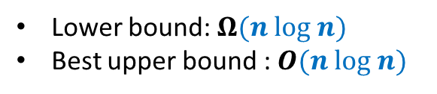
Leader Election in a complete network
Implicit
Assumption: Suppose each node has a unique id.
Complexity of Trivial algorithm:
One round
$n(n−1)$ messages
Trivial algorithm:
Each node broadcasts its id.
The node with highest id is the leader.
Can you use this assumption as a hint to design an algorithm ?
$$n=5$$
Find a leader
Deterministic algorithms
Lower bound: $Ω(n log n)$
Best upper bound : $O(n log n)$

Slide 13










What can randomization offer ?
$$T$$
$$T$$
$$H$$
$$T$$
$$H$$
$$T$$
$$H$$
$$T$$
$$T$$
$$T$$

Slide 14












What can randomization offer ?
$$T$$
$$T$$
$$H$$
$$T$$
. . . .
$$H$$
$$T$$
$$T$$
$$H$$
$$T$$
$$T$$

Slide 15
What can randomization offer ?
. . . .

Slide 16

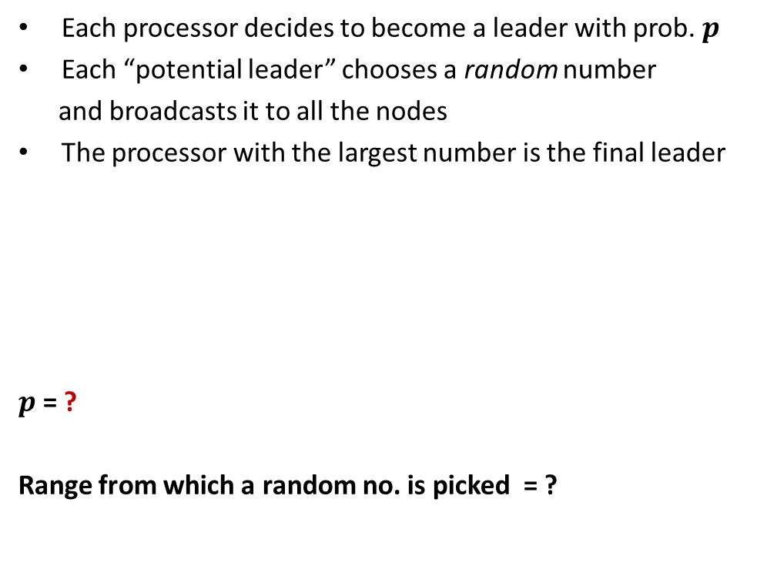

Each processor decides to become a leader with prob. $p$
Each “potential leader” chooses a random number
and broadcasts it to all the nodes
The processor with the largest number is the final leader
$p$ = ?
Range from which a random no. is picked = ?
To Ensure that there is at least one potential leader with high probability.
$$\frac{3\left(log n\right)}{n}$$
To ensure that no two potential leaders pick the same random number with high probability.
$$[1,n^{4}]$$

Slide 17

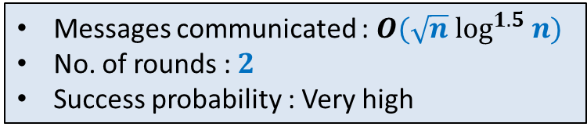
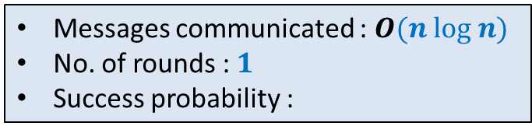
Use Birthday Paradox
Each processor decides to become a leader with prob. $p$
Each “potential leader” chooses a random number
and broadcasts it to all the nodes
The processor with the largest number is the final leader
$p$ = ?
Range from which a random no. is picked = ?
$$\frac{3\left(log n\right)}{n}$$
$$[1,n^{4}]$$
Messages communicated : $O(\sqrt{n} \log^{1.5} n)$
No. of rounds : $2$
Success probability : Very high
Messages communicated : $O(n log n)$
No. of rounds : $1$
Success probability :
Very high

Slide 18
Random walk and Electric Networks
Doyle and Snell
https://math.dartmouth.edu/~doyle/docs/walks/walks.pdf

Slide 19
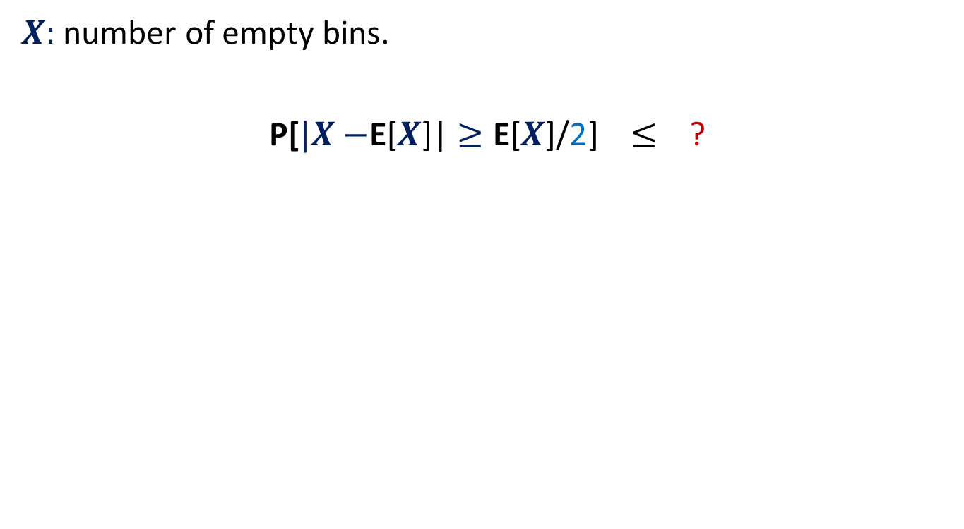










Random walk on a line
½
½
Question:
Suppose the random walk starts at $i$.
The walk terminates as soon as drunkard reaches home or bar.
What is the probability that the drunkard reaches home before reaching bar ?
Let $p(i)$ be the corresponding probability.
$p\left(0\right)=$ ?
$p\left(n\right)=$ ?
$p\left(i\right)=$ ?
bar
home
$$0$$
$$1$$
$$i−1$$
$$i$$
$$i+1$$
$$n−1$$
$$n$$
$$0$$
$$1$$
$$\frac{1}{2}p\left(i−1\right) + \frac{1}{2}p\left(i+1\right)$$

Slide 20


Random walk on a line
$V\left(i\right)$: Potential at point $i$.
$V\left(0\right)=0$, $V\left(n\right)=1$,
Current entering $i$ = Current leaving $i$.
$\frac{\left(V\left(i+1\right)−V\left(i\right)\right)}{1}$ = $\frac{\left(V\left(i\right)−V\left(i−1\right)\right)}{1}$
$V\left(i\right)=$ $\frac{1}{2}\left(V\left(i−1\right) + V\left(i+1\right)\right)$
current
$$0$$
$$1$$
$$i−1$$
$$i$$
$$i+1$$
$$n−1$$
$$n$$
$1$ Volt
Each resistance is 1 ohm.

Slide 21
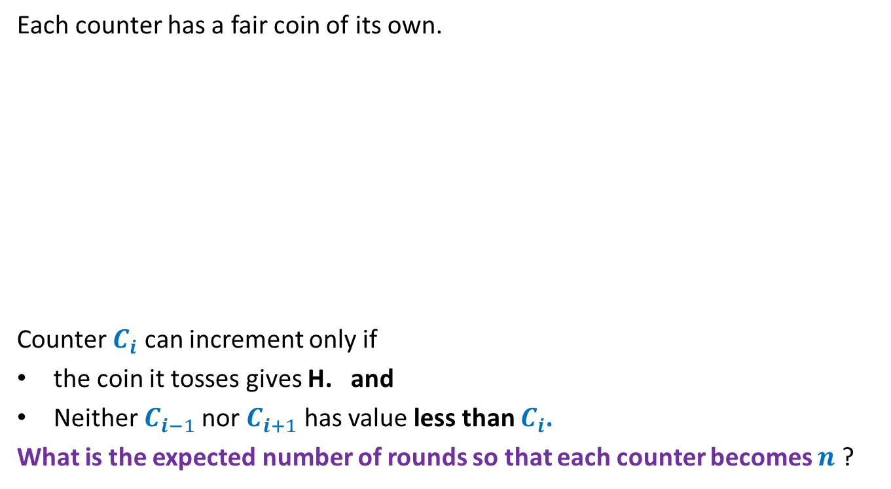
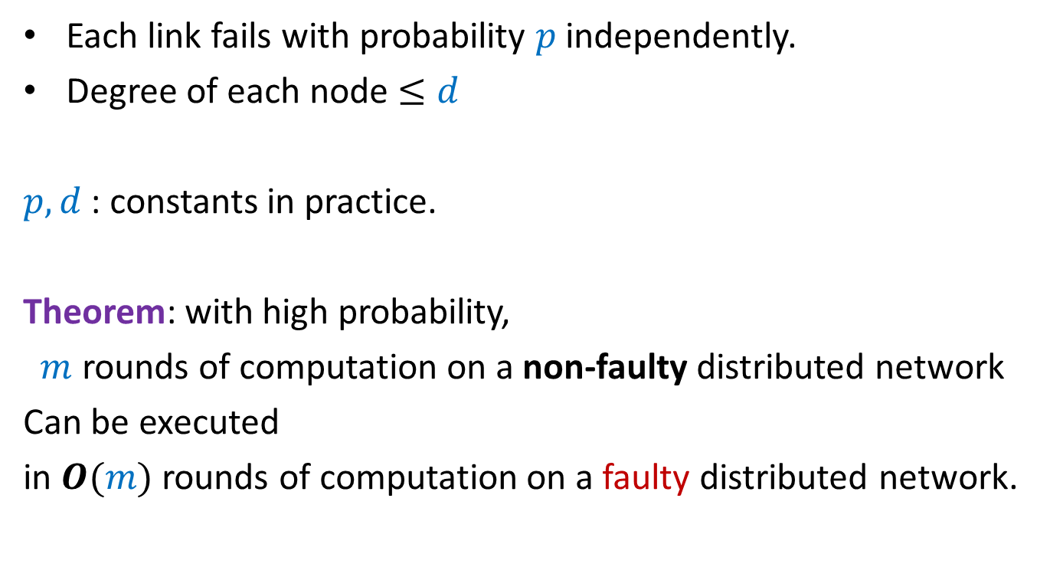
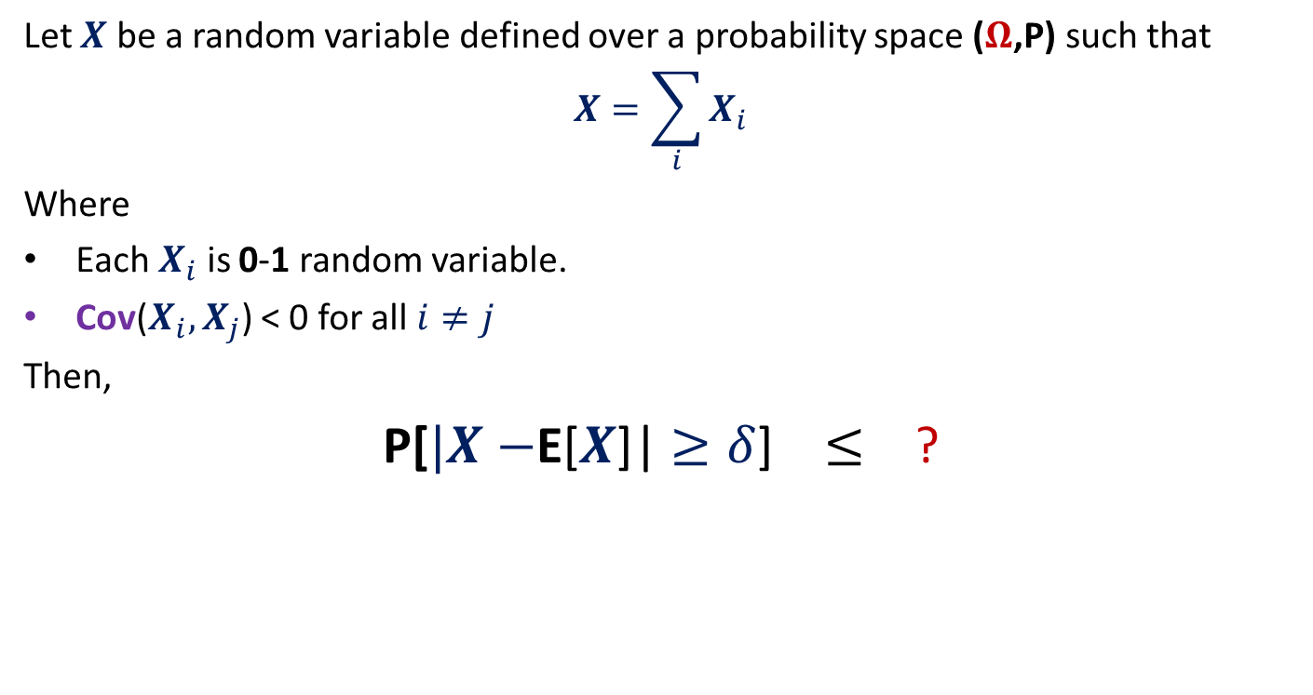

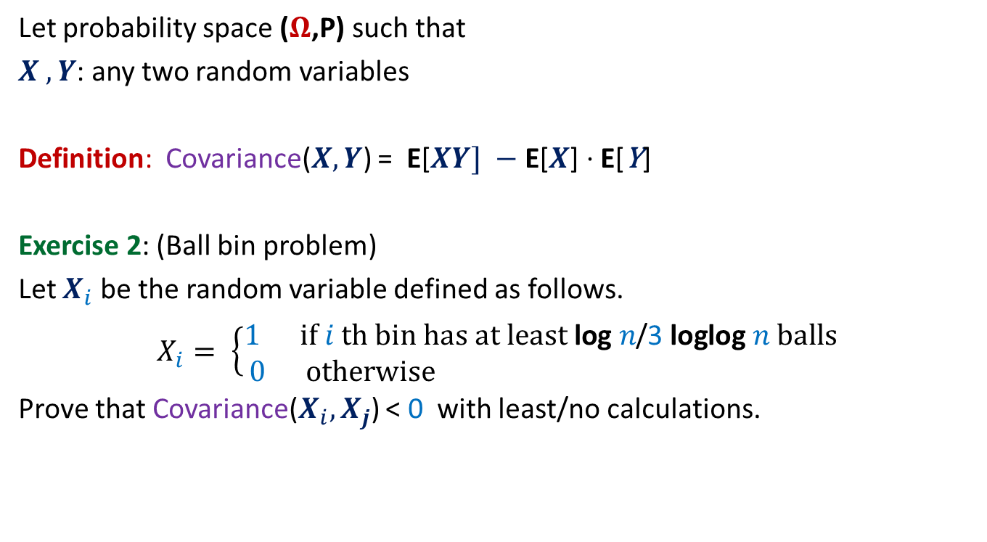



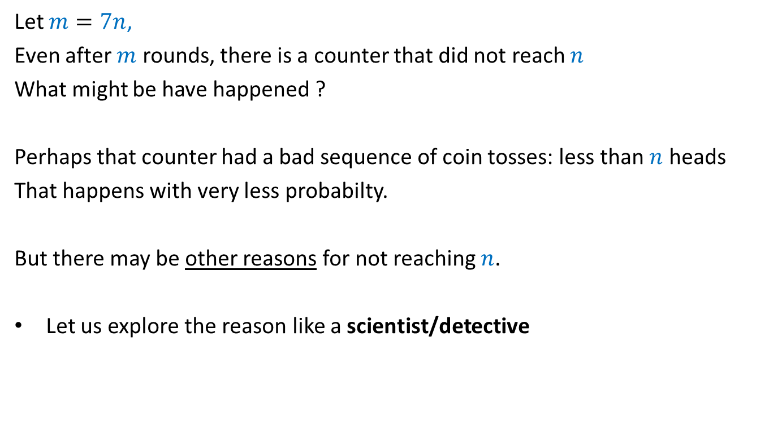
Random walk on a line
½
½
$p\left(0\right)=0$, $p\left(n\right)=1$, $p\left(i\right)=$ $\frac{1}{2}\left(p\left(i−1\right) + p\left(i+1\right)\right)$
$V\left(i\right)$: Potential at point $i$
$V\left(0\right)=0$, $V\left(n\right)=1$, $V\left(i\right)=$ $\frac{1}{2}\left(V\left(i−1\right) + V\left(i+1\right)\right)$
Hence $V\left(i\right)$ and $p\left(i\right)$ satisfy the same set of equations.
➔ If these equations have unique solution, then $V\left(i\right)=p\left(i\right)$ for all $i$.
bar
home
$$0$$
$$1$$
$$i−1$$
$$i$$
$$i+1$$
$$n−1$$
$$n$$
current
$$0$$
$$1$$
$$i−1$$
$$i$$
$$i+1$$
$$n−1$$
$$n$$
$1$ Volt

Slide 22


Harmonic function in 1-dimension
Definition: function $f$ defined on [$0,n$] is said to be harmonic function if
at each internal point $i$
Lemma: A harmonic function attains its maximum (and minimum) value at
the boundary points.
$f$($i$) = $\frac{1}{2}\left(f\text{(}i−1\text{)}\text{ +}f\text{(}i+1\text{)}\right)$
$$0$$
$$1$$
$$i−1$$
$$i$$
$$i+1$$
$$n−1$$
$$n$$
Boundary point
Boundary point
Internal points

Slide 23
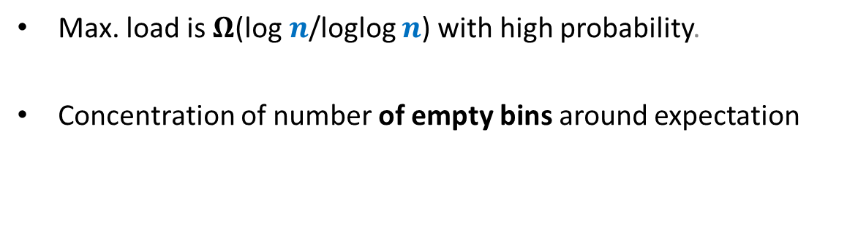
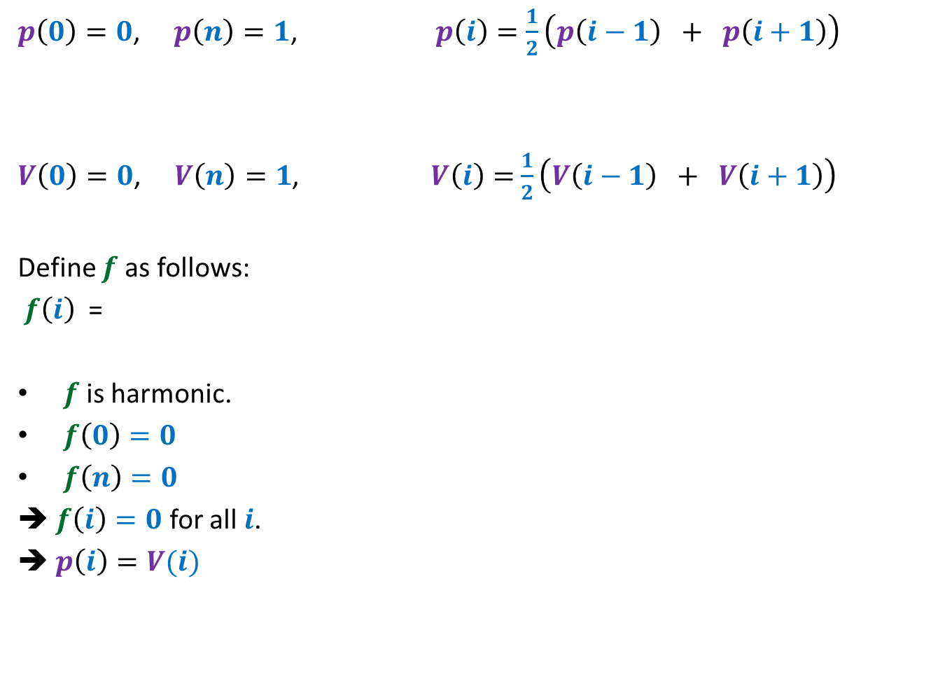
Random walk on a line
$p\left(0\right)=0$, $p\left(n\right)=1$, $p\left(i\right)=$ $\frac{1}{2}\left(p\left(i−1\right) + p\left(i+1\right)\right)$
$V\left(0\right)=0$, $V\left(n\right)=1$, $V\left(i\right)=$ $\frac{1}{2}\left(V\left(i−1\right) + V\left(i+1\right)\right)$
Define $f$ as follows:
$f\left(i\right)$ =
$f$ is harmonic.
$f\left(0\right)=0$
$f\left(n\right)=0$
➔ $f\left(i\right)=0$ for all $i$.
➔ $p\left(i\right)=V(i)$
$$p\left(i\right)−V(i)$$

Slide 24






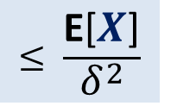
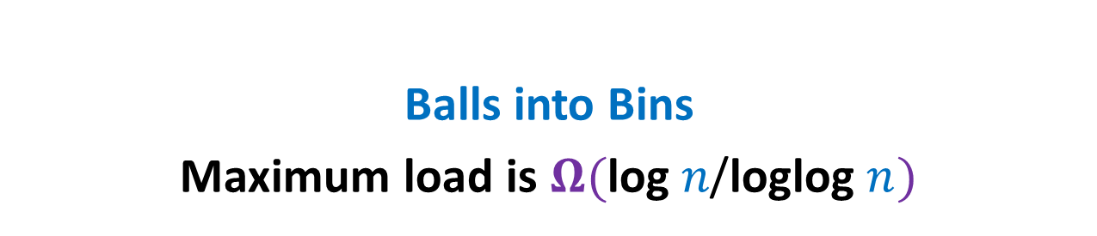



$$y$$
$$b$$
home
Question: What is $p_{x}$, probability of reaching home before bar ?
$p_{v}=0$,
$p_{c}=1$,
$p_{x}=\frac{1}{ deg(x) }\sum_{y∈N(x)}{p_{y}}$
$$c$$
bar
$$v$$
$$x$$
$$u$$
$$g$$
$$d$$
$$a$$
$$z$$

Slide 25

1 volt
$$y$$
$$b$$
Question: What is relation between $V_{x}$ and $V_{y}$’s where $y∈N(x)$ ?
$V_{v}=0$,
$V_{c}=1$,
Net current leaving $x$is 0.
$\sum_{y∈N(x)}{{(V}_{x}−V_{y}) \text{=0}}$
➔ $V_{x}=\frac{1}{ deg(x) }\sum_{y∈N(x)}{V_{y}}$
$$c$$
$$v$$
$$x$$
$$u$$
$$g$$
$$d$$
$$a$$
$$z$$

Slide 26


$$y$$
$$b$$
Question: What is relation between $V_{x}$ and $V_{y}$’s where $y∈N(x)$ ?
$V_{v}=0$,
$V_{c}=1$,
$$V_{x}=\frac{1}{ deg(x) }\sum_{y∈N(x)}{V_{y}}$$
Hence $V_{x}$ and $p_{x}$ satisfy the same set of equations.
➔ Since these equations have unique solution, therefore $V_{x}=p_{x}$ for all $x$.
$$c$$
$$v$$
$$x$$
$$u$$
$$g$$
$$d$$
$$a$$
$$z$$
$p_{v}=0$,
$p_{c}=1$,
$$p_{x}=\frac{1}{ deg(x) }\sum_{y∈N(x)}{p_{y}}$$

Slide 27
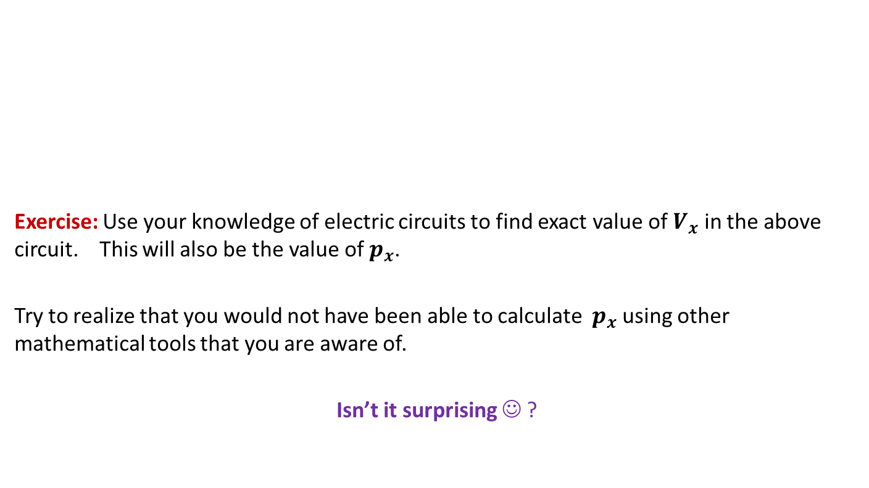
$$y$$
$$b$$
Exercise: Use your knowledge of electric circuits to find exact value of $V_{x}$ in the above circuit. This will also be the value of $p_{x}$.
Try to realize that you would not have been able to calculate $p_{x}$ using other mathematical tools that you are aware of.
Isn’t it surprising ☺ ?
$$c$$
$$v$$
$$x$$
$$u$$
$$g$$
$$d$$
$$a$$
$$z$$

Slide 28
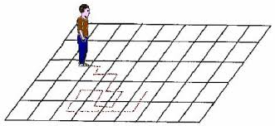
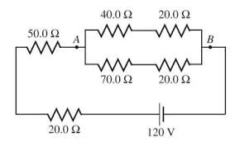
A surprising discovery
Random walk
Electric networks
A. K. Chandra, P. Raghavan, W. L. Ruzzo, R. Smolensky, P. Tiwari: The Electrical Resistance of a Graph Captures its Commute and Cover Times
(Detailed Abstract). STOC1989: 574-586

Slide 29





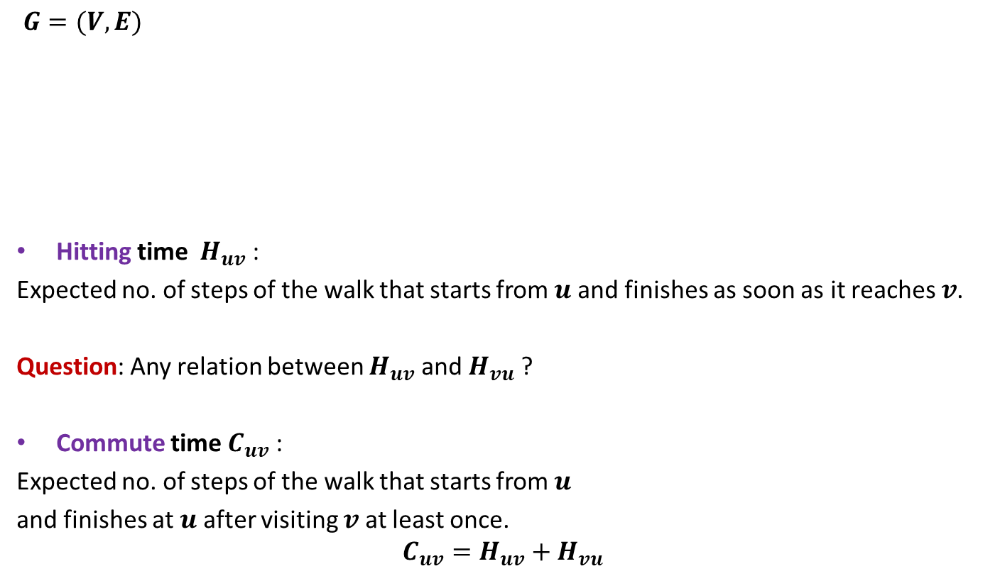






Notations
$$j$$
$$y$$
$$b$$
$G=(V,E)$
Hitting time $H_{uv}$ :
Expected no. of steps of the walk that starts from $u$ and finishes as soon as it reaches $v$.
Question: Any relation between $H_{uv}$ and $H_{vu}$ ?
Commute time $C_{uv}$ :
Expected no. of steps of the walk that starts from $u$
and finishes at $u$ after visiting $v$at least once.
$$C_{uv}=H_{uv}+H_{vu}$$
$$c$$
$$v$$
$$x$$
$$u$$
$$g$$
$$d$$
$$a$$
$$z$$
NO

Slide 30


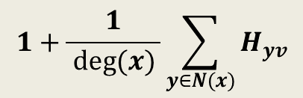
Expressing $H_{xv}$ through equations
$$y$$
$$b$$
$H_{xv}=$ ?
$$c$$
$$v$$
$$x$$
$$u$$
$$g$$
$$d$$
$$a$$
$$z$$
$$1+\frac{1}{ deg(x) }\sum_{y∈N(x)}{H_{yv}}$$

Slide 31
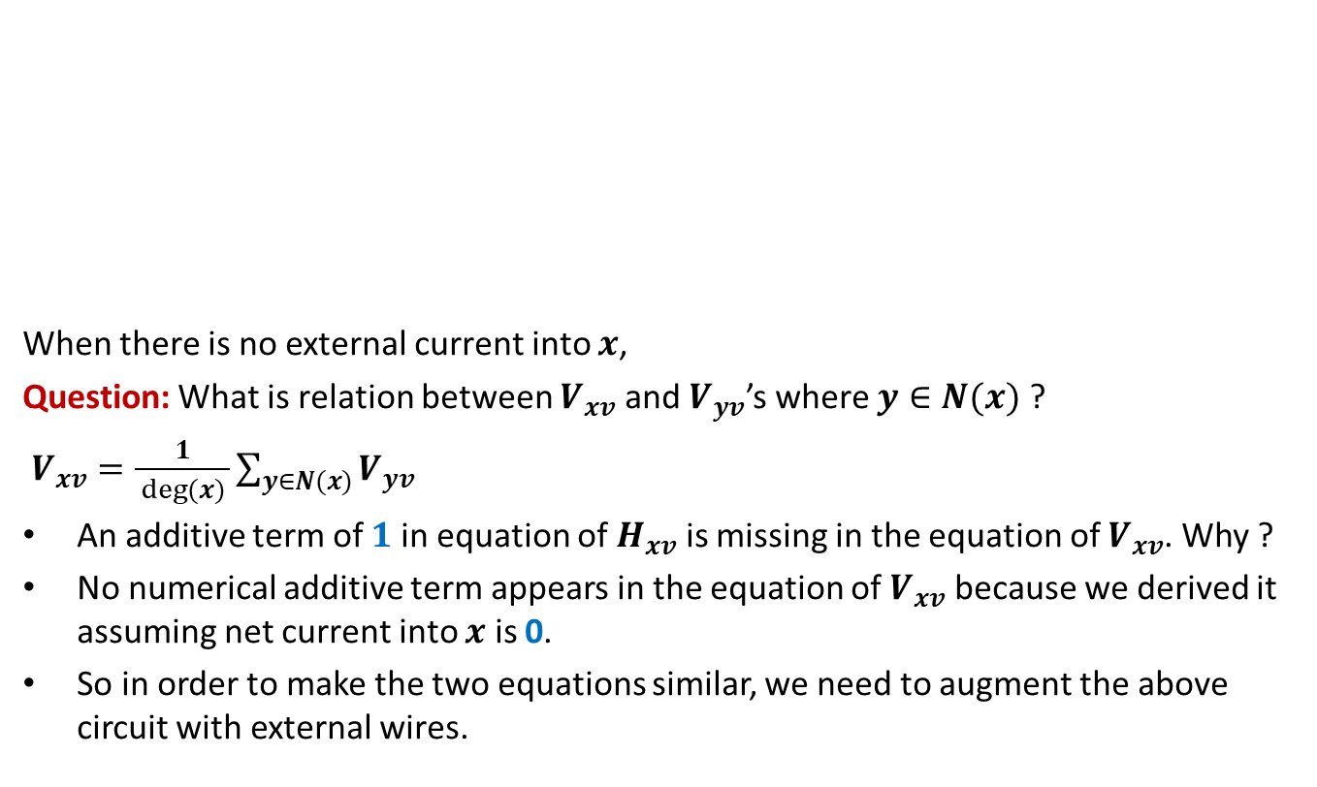

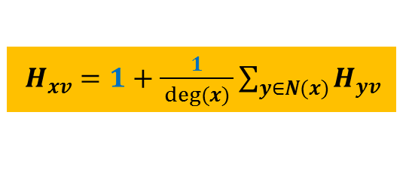
Expressing $H_{xv}$ through a circuit
$$y$$
$$b$$
When there is no external current into $x$,
Question: What is relation between $V_{xv}$ and $V_{yv}$’s where $y∈N(x)$ ?
$V_{xv}=\frac{1}{ deg(x) }\sum_{y∈N(x)}{V_{yv}}$
An additive term of $1$ in equation of $H_{xv}$ is missing in the equation of $V_{xv}$. Why ?
No numerical additive term appears in the equation of $V_{xv}$ because we derived it assuming net current into $x$ is 0.
So in order to make the two equations similar, we need to augment the above circuit with external wires.
$$c$$
$$v$$
$$x$$
$$u$$
$$g$$
$$d$$
$$a$$
$$z$$
$H_{xv}=1+\frac{1}{ deg(x) }\sum_{y∈N(x)}{H_{yv}}$

Slide 32


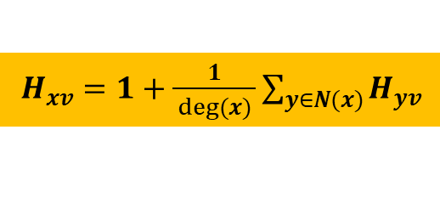
Expressing $H_{xv}$ through a circuit
$$y$$
$$b$$
Let $I_{x}$ be the current injected into $x$ from outside.
Question: What is the new relation between $V_{xv}$ and $V_{yv}$’s where $y∈N(x)$ ?
$V_{xv}=\frac{I_{x}}{deg(x)}+\frac{1}{ deg(x) }\sum_{y∈N(x)}{V_{yv}}$
Question: What should be $I_{x}$ in order to equate equations of $V_{xv}$ and $H_{xv}$?
➔ We must extract $2m−deg(v)$ current from $v$ to satisfy Kirchoff’s current law.
$$c$$
$$v$$
$$x$$
$$u$$
$$g$$
$$d$$
$$a$$
$$z$$
$H_{xv}=1+\frac{1}{ deg(x) }\sum_{y∈N(x)}{H_{yv}}$
$$I_{x}=deg(x)$$

